Slide 1
Computer Architecture
Prof. Saurabh Gandhi (EEE department)

Slide 2
Instructions as seen by hardware

Slide 3
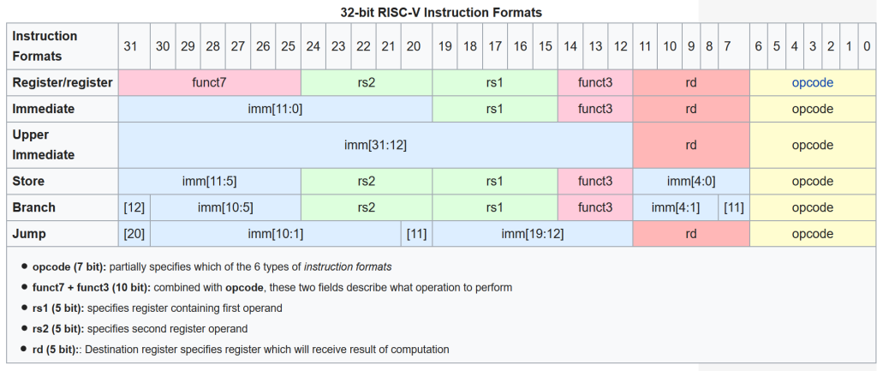
The 6 basic RV32I instruction formats – R, I, S, B, U, J

Slide 4
General structure of instructions
opcode (7 bits): operation code, what operation to perform
rd (5 bits): destination register, for the result of the operation
rs1, rs2 (5 bits each): source registers, or operands
funct3 (3-bit), funct7 (7-bit): refine operation
imm: immediate, directly provide a literal value

Slide 5
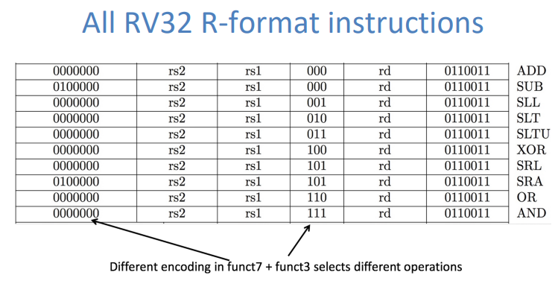
R-format instructions
opcode: instruction class (e.g., integer ALU)
funct3: selects ALU operation group
funct7: refines operation (e.g., add vs sub)

Slide 6
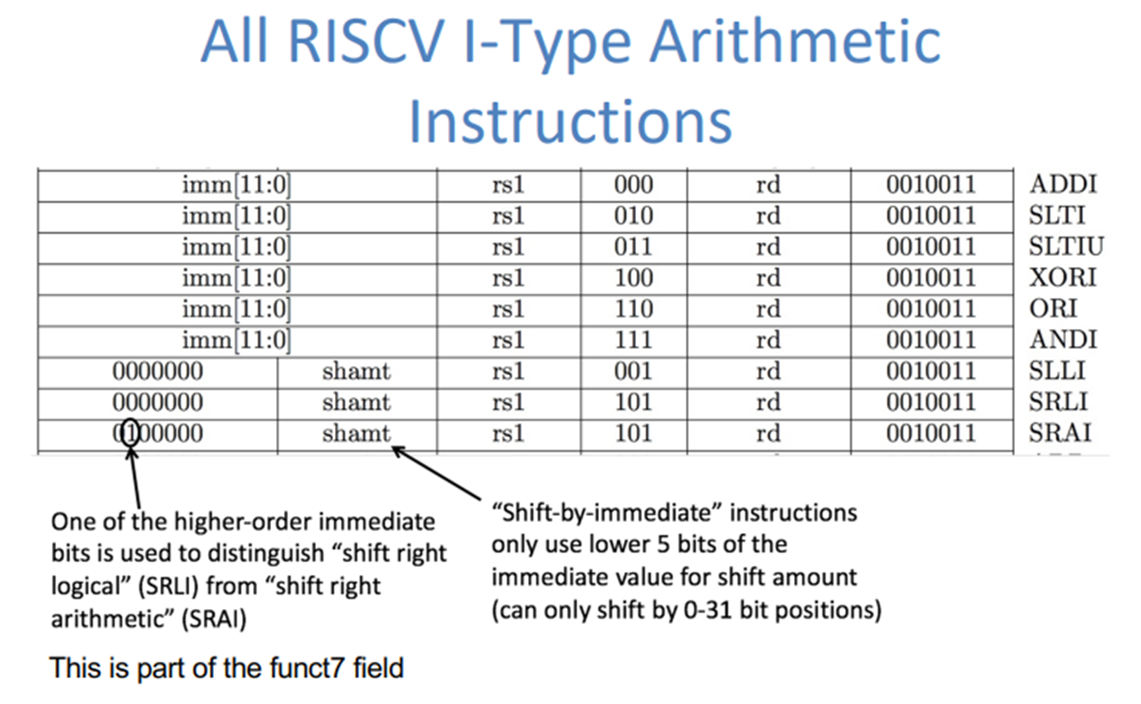
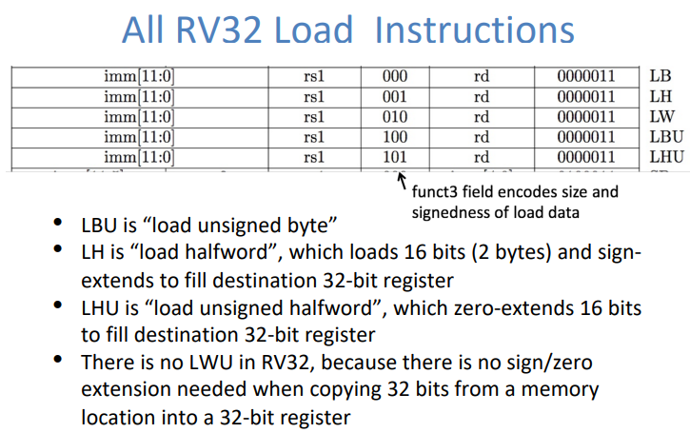
I-format instructions

Slide 7
Notice any quirks?
What happened to func7 in I-type arithmetic?
Why not use the same encoding logic for operation?
I-types prefer more bits for Imm
Why not remove func7 from R-type also?
Fewer R-type instructions supported (currently 10 R-type instructions, so 3 func3 bits insufficient)
I-type does not have subi (and jugglery for shifts)
Hierarchical decoding – next class!

Slide 8
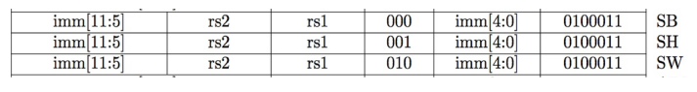
S-format instructions
More quirks!
Why is imm split?
Prefer rs1, rs2, rd (whenever required) in the fixed locations – simplifies decoding circuit

Slide 9
Full picture
Opcode (binary) | Opcode (hex) | Instruction Class | Format(s) | Role of funct3 | Role of funct7
0110011 | 0x33 | Integer register–register ALU | R-type | Selects ALU operation group (ADD/SUB, AND/OR, shifts, SLT) | Distinguishes operations sharing same funct3 (e.g., ADD vs SUB, SRL vs SRA)
0010011 | 0x13 | Integer register–immediate ALU | I-type | Selects immediate ALU operation (ADDI, ANDI, ORI, shifts) | Used only for shift immediates (slli, srli, srai)
0000011 | 0x03 | Loads | I-type | Selects load width (lb, lh, lw, etc.) | Not used
0100011 | 0x23 | Stores | S-type | Selects store width (sb, sh, sw) | Not used
1100011 | 0x63 | Conditional branches | B-type | Selects comparison type (beq, bne, blt, bge, etc.) | Not used
1101111 | 0x6F | Jump and link | J-type | Not used | Not used
1100111 | 0x67 | Jump and link register | I-type | Fixed (000) | Not used
0110111 | 0x37 | Load upper immediate | U-type | Not used | Not used
0010111 | 0x17 | Add upper immediate to PC | U-type | Not used | Not used
1110011 | 0x73 | System / CSR | I-type | Selects CSR operation | Further refines system behavior

Slide 10
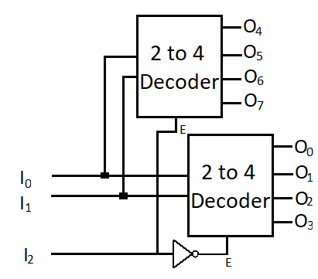
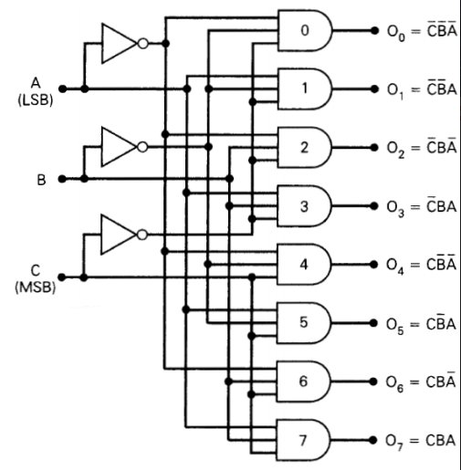
Review questions
Two possible designs of 3-to-8 decoders:
A B

Slide 11
Microarchitecture – datapath

Slide 12
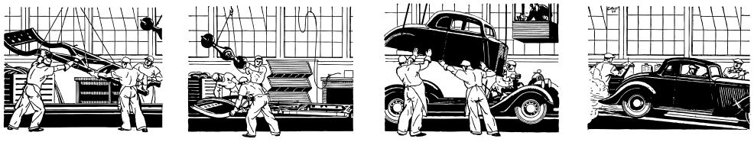
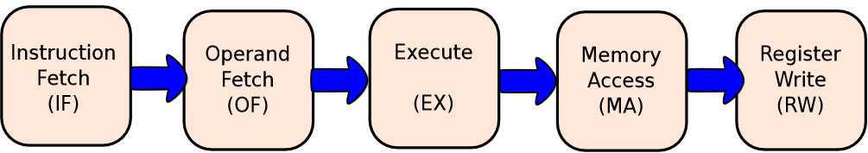
How is an instruction executed?
Goal: Create a “circuit” of logic elements that, when given an assembly instruction, perform the action the instruction describes

Slide 13
The stages of instruction execution – Instruction Fetch (IF)
Which instruction to fetch? Logical elements to compute the address of the next instruction
Next instruction – easy, just increment the current instruction address by size
Branch – depends on the outcome of the current instruction (information obtained from other units of the processor

Slide 14
The stages of instruction execution – Decode and Operand Fetch (OF)
How to interpret the instruction? What all will be needed to execute it?
Processing required for different instruction types is very different – load-store instructions use a dedicated memory unit, whereas arithmetic instructions do not
Notes:
R-type: register-register.
I-type: short immediates and loads.
S-type: stores.
B-type: conditional branches, a variation of S-type.
U-type: long immediates.
J-type: unconditional jumps, a variation of U-type.

Slide 15
The stages of instruction execution – Execute (EX)
Executes arithmetic and logical operations
Contains an arithmetic and logical unit (ALU)
Compute the effective address of load-store operations
Computes the outcome of branches

Slide 16
The stages of instruction execution – Memory Access (MA)
Processing load-store instructions (accessing main memory)
Memory system can be very complex, and part of that complexity is implemented here (next module!)

Slide 17
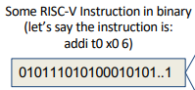
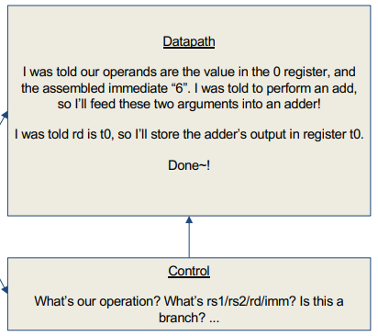
Data and control path
Datapath: contains the hardware necessary to perform operations required by the processor Reacts to what the controller tells it! (ie. “I was told to do an add, so I’ll feed these arguments through an adder)
Control: decides what each piece of the datapath should do What operation am I performing? Do I need to get info from memory? Should I write to a register? Which register? (Based on the input instruction!)

Slide 18
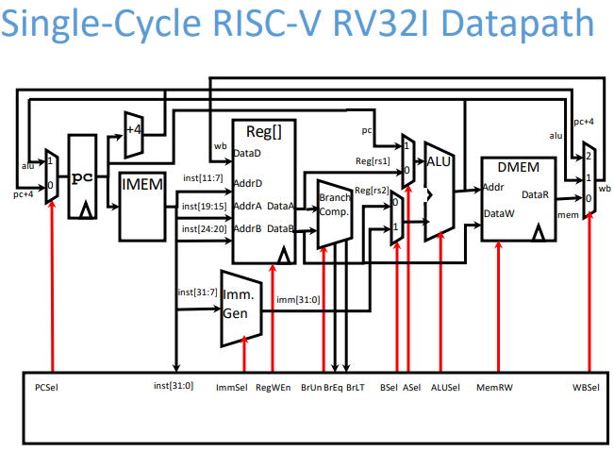
The final product – virtual

Slide 19
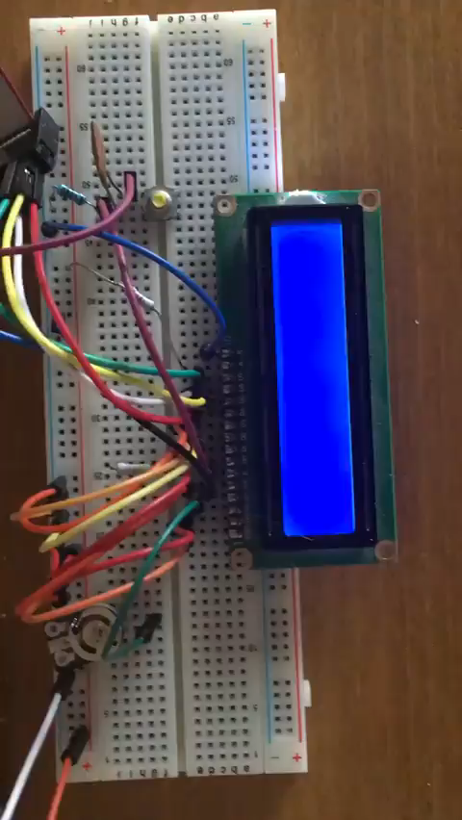
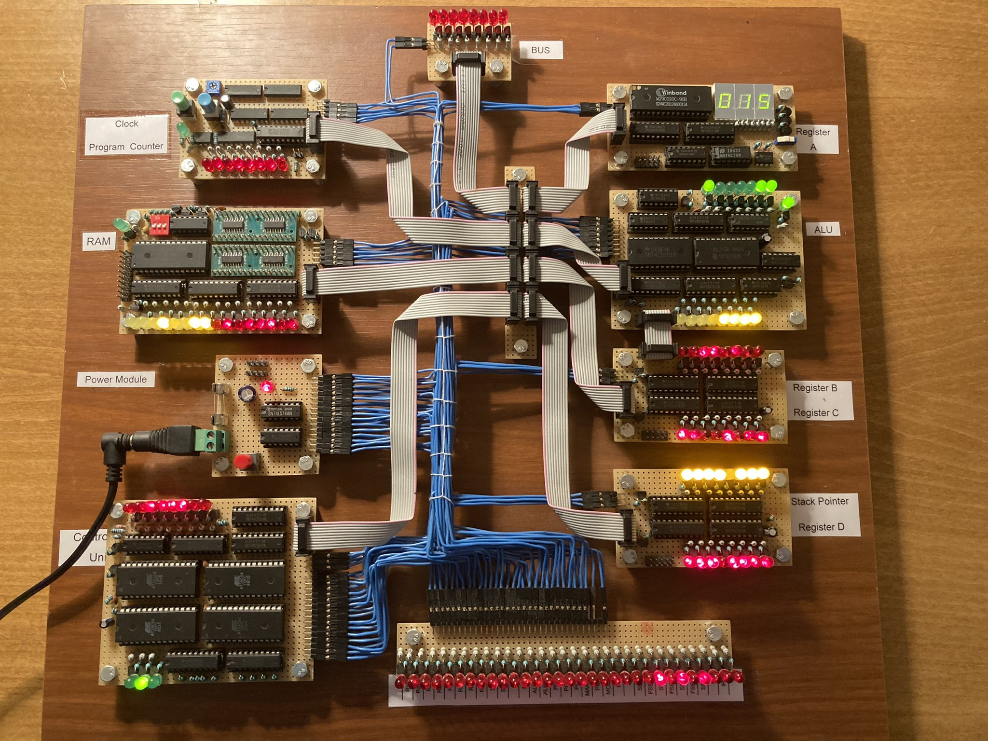
The final product – physical!
https://twitter.com/ten_filip/status/1340400266047332354
https://eater.net/8bit
Try your own: https://hackaday.io/project/178826-pineapple-one/details

Slide 20
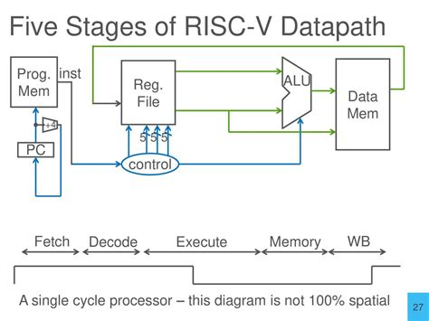
Components of the datapath

Slide 21
What hardware blocks does an instruction use?
Program memory – where the instructions come from
PC – register that points to the instruction in memory
Register File – where the local registers live
Immediate generator
ALU – where the computation happens
Data memory

Slide 22
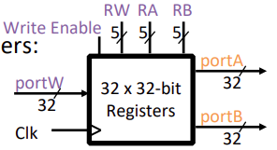
The RV32I Register File
32 integer registers, x0 to x31
Output ports portA and portB (readout of 32 bit data stored inside)
Input port portW (32 bit data that we want to write inside)
RW, RA, RB (address of register inside the RF resp.)
WEn (whether to copy portW data into register inside or not)
Clk (clock signal for write operation, read is combinational)!
Register x0 is hardwired to 0 (why?)
General purpose usage (ie registers are not restricted or reserved for specific uses)

Slide 23
Immediate generator
Immediates are weirdly scattered
Immediates are not 32-bit (but ALU requires 32-bit inputs)
What ImmGen does:
Reassemble bits
Sign extend
(+74) 01001010 → 0000000001001010
(-74) 10110110 → 1111111110110110
Alignment (for branching and jumping)
00000001000 (11 bits) → 000000010000 (12 bits)

Slide 24
The ALU
Performs arithmetic (ADD, SUB) and logical (AND, OR, XOR) operations
Inputs:
two 32-bit values + 4-bit ‘operation select’
Outputs:
32-bit result + ‘zero’ flag
Which instructions would use the ALU?

Slide 25
Program counter
Address of current instruction
Updated every instruction
PC ← PC + 4
PC ← PC + offset (branch)
PC ← target address (jump)

Slide 26
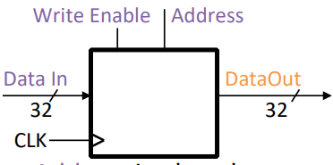
Instruction and data memory
Memory (idealized)
One input port: Data In
One output port: Data Out
Memory access:
Read: Write Enable = 0, data at Address is placed on Data Out
Write: Write Enable = 1, Data In written to Address
Clock input (CLK)
CLK input is a factor ONLY during write operation
During read, behaves as a combinational logic block: Address valid → Data Out valid after “access time”

Slide 27
Control – one circuit to rule them all

Slide 28
Instruction decode and control

Slide 29
Instruction Fetch (IF) has fetched 32 bits of an instruction
Now what?
Instruction decode
Extract different fields from the instruction
Generate control signals that activate appropriate datapath components
Generate immediate
Every instruction is decoded, so strongly affects timing and power!

Slide 30
Control- and data- relevant bits
Control relevant information:
Opcode
Func3
Func7
Data-relevant information:
rs1, rs2, rd
immediate

Slide 31
What all does Control control?
Write to register file? RegWrite
Register writes from ALU result or memory? MemToReg
Write to data memory? MemWrite
ALU – what operation to perform? ALUop
ALU – what inputs to select (register or immediate)? ALUSrc
Muxes
PC – +4 or new? PCSel

Slide 32
Bit slicing – extracting instruction fields
32-bit bus split into dedicated wires with downstream connections
Data relevant bits
Register file address inputs
Immediate generator inputs
Control relevant bits
Main control unit to decide what signals to generate

Slide 33
Hierarchical decoding of control bits
Decoding the opcode
0110011: R-type
0010011: I-type
0000011: Load
1100011: Branch
If opcode says R-type, Main Control knows it has to set RegWrite = 1 (ie write back is surely involved)
Lets ALU Control decide what operation to perform
Main Control smaller and faster
ALU Control only if required by the instruction

Slide 34
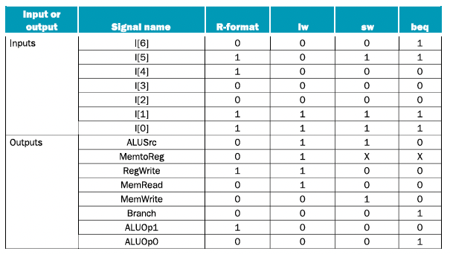
Instruction class based control

Slide 35
ALU Control
Main Control sends 2-bit signal to ALU (ALUop)
00: Force ADD (for load/store instructions)
01: Force SUB (for branch comparisons)
10: Use func3 and func7 to decide operation
ALU decoder / control:
Inputs: ALUop, func3, func7
Output: 4-bit ALU operation select

Slide 36
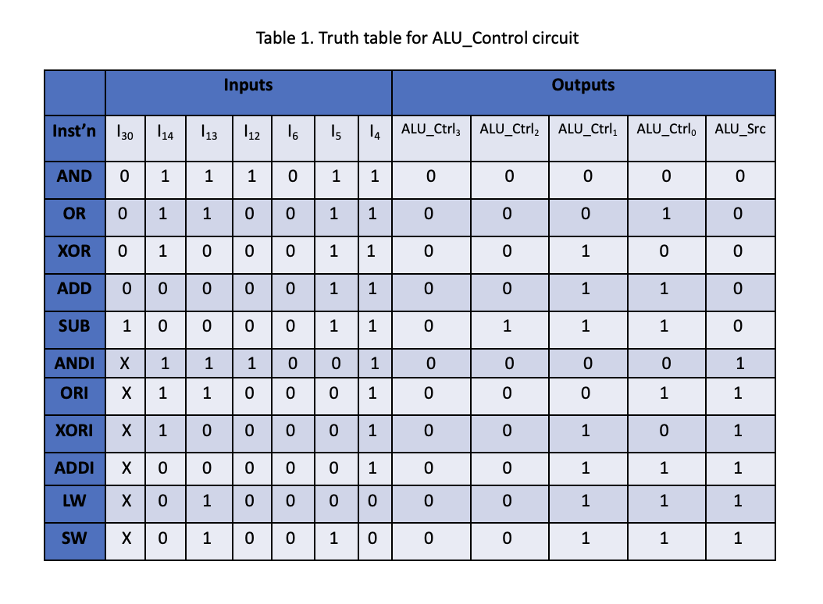
ALU Control

Slide 37
Decode Walkthrough: add x5, x3, x4
Opcode → ALU instruction
funct3 = 000 → add/sub group
funct7 = 0000000 → ADD
Control signals:
read rs1, rs2
select ALU add
enable register write
PC ← PC + 4

Slide 38
Decode Walkthrough: lw x5, 8(x10)
Opcode → load class
funct3 = 010 → word load
Immediate generation enabled
Control signals:
ALU computes address memory
read enabled
register write enabled

Slide 39
Building a datapath for R-type instructions
Let us work with an example instruction: add t0 t2 t3
What steps do you need to execute? Remember we had a list of 5 steps:
1. Fetch: add t0 t2 t3
2.1 Decode: rd = t0; rs1 = t2; rs2 = t3
2.2 Operand fetch (read data): R[t2] R[t3]
3. Execute (perform operation): R[t2] + R[t3]
5. Write results back into register: R[t0] = R[t2] + R[t3]

Slide 40
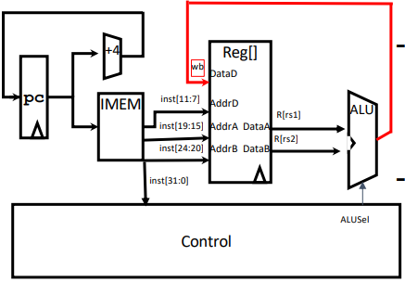
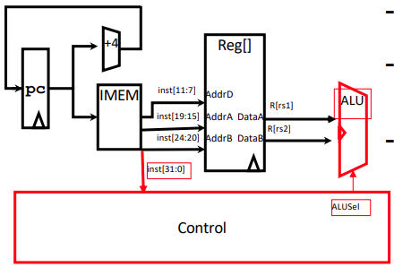
Implementing R-type instructions
Instruction fetch
PC contains instruction address
Connect to IMEM input (address bus)
How is PC updated after the instruction? PC ←PC + 4
Instruction appears on IMEM data bus
Decode / operand fetch
Slice register address fields and connect to RegFile address input
Corresponding data appears at output of RegFile
Execute
Operands provided to ALU
What operation to perform?
Control signals!
Control unit receives opcode, func3 and func7
Generates ALUSel (or ALUOp)
Writeback
Another control signal to enable RegWrite

Slide 41
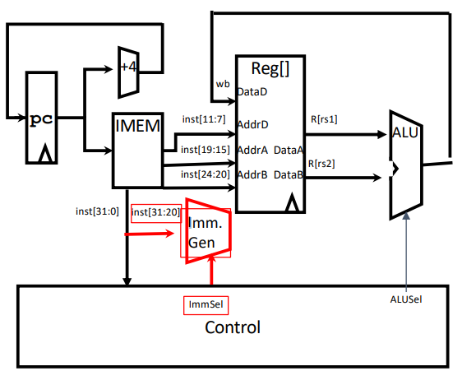
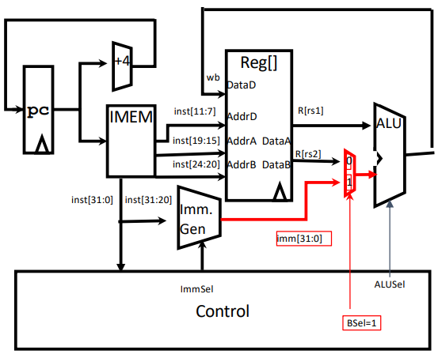
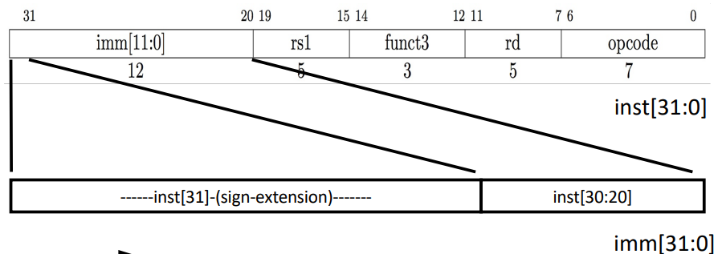
Adding I-type arithmetic instructions to the datapath
1. Fetch: addi t0 t2 28
2.1 Decode (parse the instruction and extract different fields): rd = t0; rs1 = t2; rs2 = t3; imm
2.2 Operand fetch (read data): R[t2] R[t3] imm
3. Execute (perform operation): R[t2] + R[t3] + imm
5. Write results back into register: R[t0] = R[t2] + R[t3] + imm
Notes:
What does ImmSel do?
What does BSel do?

Slide 42
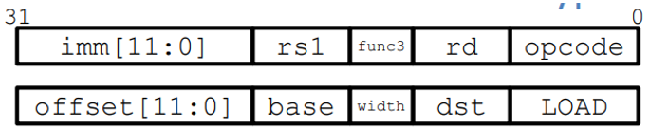
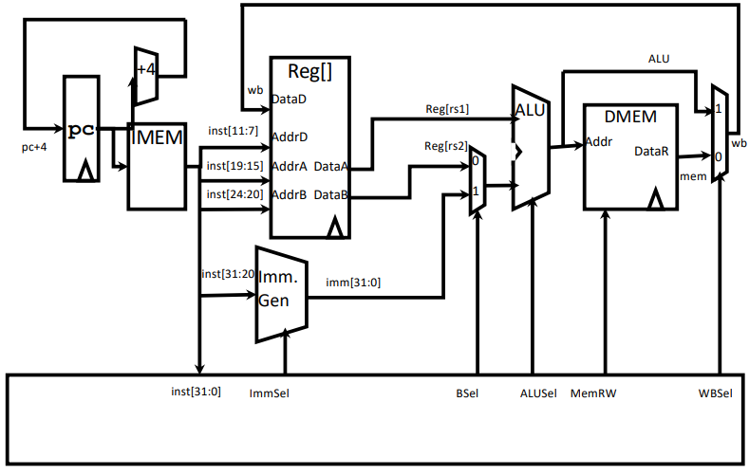
Adding I-type load instructions to the datapath
Do we need to change hardware, control, or both?
Can we fetch our instruction?
YES!
Can we decode our instruction?
YES!
Can we select the operands we need?
YES! (still R[rs1] and immediate)
Do we have support for the operation we’re performing?
YES! (ALUSel = Add)
Can we access memory?
Need to add one!
Anything else needs to be changed?
Register writeback needs to come from DMEM not ALU output!

Slide 43
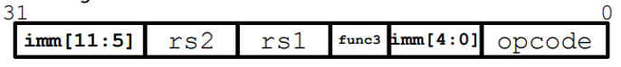
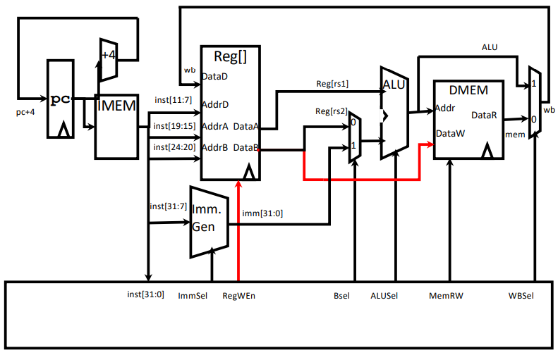
Adding S-type (store) instructions to the datapath
What do we need to change to support storing?
Do we need to update R[rd]?
No! Stores don’t write back to register file!
Need a new control bit
What gets stored in DMEM?
R[rs2]

Slide 44
What kinds of instructions are still remaining?
Done: R-type arithmetic, I-type arithmetic, I-type load and I-type store
Modify registers Modify memory
Change program flow: Jumps and branching!
What key features do they require?
Modify the PC

Slide 45
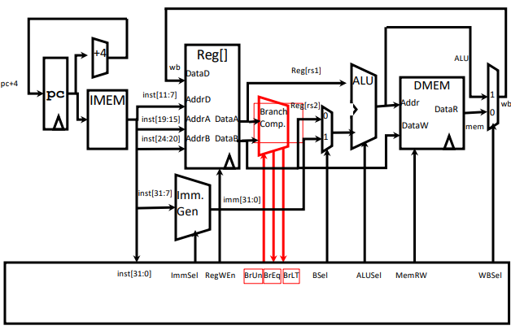
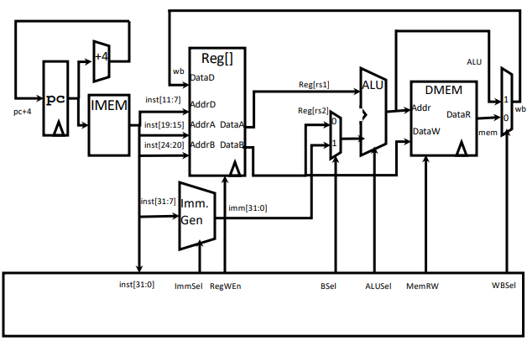
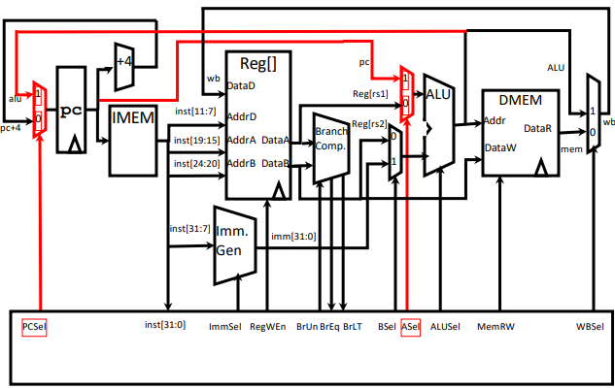
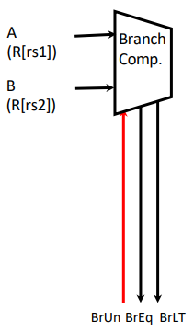
Implementing branches
What operations do we need for branching?
Comparison (R[rs1] == R[rs2])
Addition (PC = PC + Imm)
Do we have the required hardware already?
Our ALU can do one of these, but not both! We need to add more hardware!
BrEq = 1, if A=B
BrLT = 1, if A < B
BrUn = 1 selects unsigned comparison for BrLT, 0 = signed
“Output” control signals are used to set other controls!
How many more muxes do we need to complete the datapath for beq support?

Slide 46
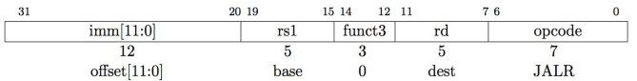
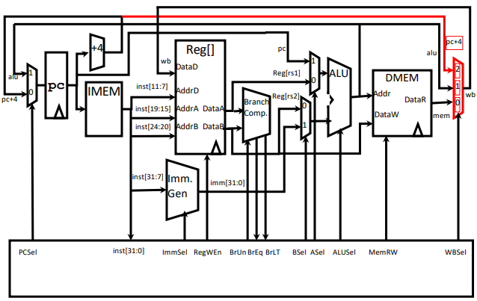
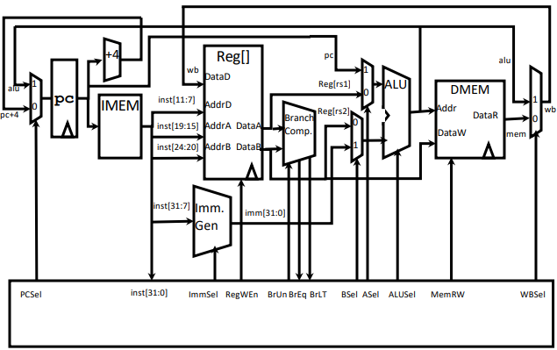
Implementing jumps
JALR rd, rs, immediate
How many operations do we need to perform?
Do we need more hardware to implement them, like beq?
Write PC+4 to Reg[rd]
Change writeback mux to accommodate another source
PC = Reg[rs1] + immediate
Uses same immediates as arithmetic and loads
no multiplication of imm by 2 for alignment (for jalr)
Should we skip alignment?
How do we ensure alignment?
No!
Mask bit 0!

Slide 47
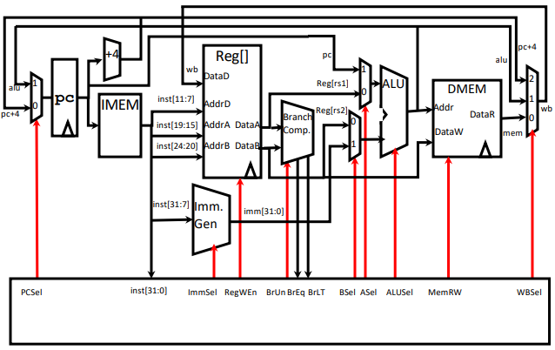
The entire RISC-V RV32l datapath

Slide 48
The control logic
Is control logic combinational or sequential?
Control signals do not depend on previous state!
Hierarchical:
Level 1: opcode based (instruction class)
Higher levels: func3, func7

Slide 49
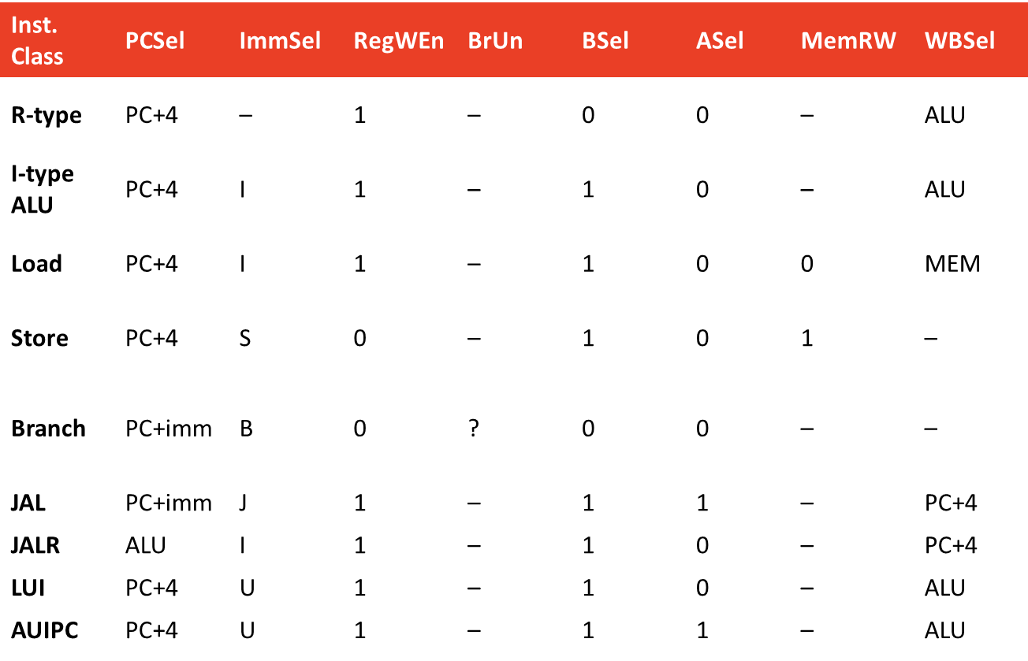
The control truth table

Slide 50
Implementing control logic
Combinational hardwired logic
Programmable (ROM / PLA based)
What are the trade-offs?
Combinational:
Hardwired, so cannot be modified
Less expensive
Programmable:
Fix errors
Add new instructions

Slide 51
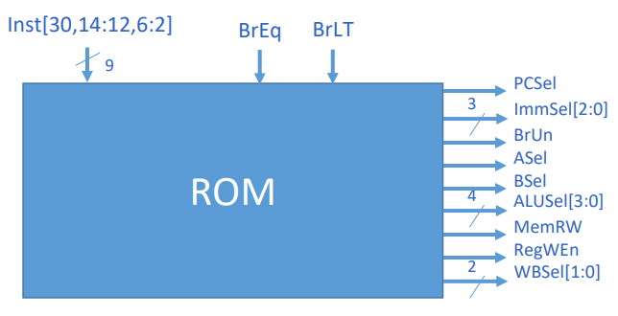
ROM based controller

Slide 52
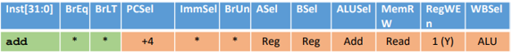
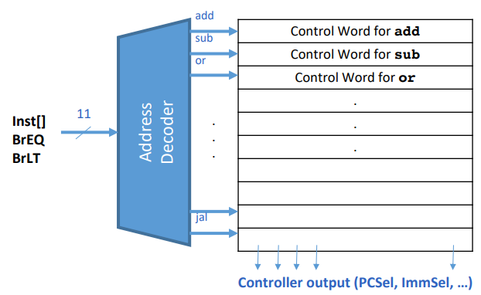
ROM based controller
Think of new instructions that you can design with this datapath!
Notes:
mv rd, rs
neg rd, rs
inc rd
abs rd, rs
li rd, imm
getpc rd
seqz rd, rs (rd ← (rs == 0) ? 1 : 0)
swp rs, imm(rd):
Mem[rd + imm] ← rs
rd ← rd + imm
pcadd rd, rs1
nop-store rs2, (rs1)

Slide 54
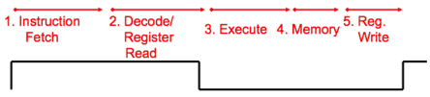
How does information flow through the data path?
Let us start with the PC, assuming a new value is just loaded into the PC… T = 0
When will the new PC be available at PC output?
T = T_{reg_transfer}
When will the data from current PC appear from IMEM?
T = T_{mem_access}
Assume R-type instruction: when will data from registers appear at the output?
How long does addition / arithmetic take?
T = T_{ALU}
What about other components – AND / OR / NOT gates, (de)multiplexers etc.?
Single Cycle CPU: All processing completes in one clock cycle!

Slide 55
How long does it take to process one full instruction?
memory units (read or write): 200 ps
ALU and adders: 100 ps
register file (read or write): 50 ps
other combinational logic: 0 p

Slide 56


Instruction execution time: R-type
memory units (read or write): 200 ps
ALU and adders: 100 ps
register file (read or write): 50 ps
other combinational logic: 0 p
100 ps
0 ps
0 ps
100 ps
50 ps
50 ps
200 ps
Time needed between two rising edges for correct execution: 400 ps

Slide 57


Instruction execution time: I-type arithmetic
memory units (read or write): 200 ps
ALU and adders: 100 ps
register file (read or write): 50 ps
other combinational logic: 0 p
100 ps
0 ps
0 ps
100 ps
50 ps
50 ps
200 ps
Time needed between two rising edges for correct execution: 400 ps
0 ps

Slide 58


Instruction execution time: I-type load
memory units (read or write): 200 ps
ALU and adders: 100 ps
register file (read or write): 50 ps
other combinational logic: 0 p
100 ps
0 ps
0 ps
100 ps
50 ps
200 ps
50 ps
200 ps
Time needed between two rising edges for correct execution: 600 ps
0 ps

Slide 59



Instruction execution time: Store
memory units (read or write): 200 ps
ALU and adders: 100 ps
register file (read or write): 50 ps
other combinational logic: 0 p
100 ps
0 ps
0 ps
100 ps
50 ps
200 ps
50 ps
200 ps
Time needed between two rising edges for correct execution: 550 ps
0 ps

Slide 60



Instruction execution time: Branch
memory units (read or write): 200 ps
ALU and adders: 100 ps
register file (read or write): 50 ps
other combinational logic: 0 p
100 ps
0 ps
100 ps
50 ps
50 ps
200 ps
Time needed between two rising edges for correct execution: 300 ps
0 ps

Slide 61
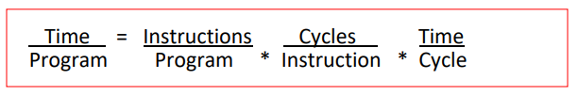
Single-cycle processor – performance metrics
How long does the clock cycle have to last?
Clock cycle time of the microarchitecture is determined by how long it takes to complete the slowest instruction
Critical path of the design is determined by the processing time of the slowest instruction
What is the fastest processor speed possible for a single cycle RV32I CPU?
1/(600 ps) == 1.33 GHz
Execution time
Energy consumption

Slide 62
The shortcomings of a single cycle CPU
Simple instructions wait unnecessarily to accommodate loner instructions
Hardware is underutilized
Energy inefficient
Why?
Unnecessary switching, charging and discharging of long, monolithic datapath
Long combinational paths increase capacitance
Voltage cannot be reduced much because paths are long and timing is tight
Limited clock frequency
Memory access is very very slow in practice
Wire delays dominate in long datapaths in the GHz range
Clock skew becomes dominant at high frequencies and long paths
Voltage has to increase with frequency → high power dissipation → heating

Slide 63
Purpose of labs
Evaluation – it is like a quiz!
An opportunity to apply what we learnt in class and deepen our understanding
Copy and get some free marks
A means for instructors to reduce grades of those who are ill or unable to attempt

Slide 64
Hierarchy of reasons to make an honest attempt
Moral / ethics: Being honest in our efforts is what distinguishes us from other species.
Learning: If you put in honest effort, you will actually end up learning something!
Marks: If you put in honest effort, I can guarantee that you will do better in the exams. Because several concepts will automatically become clear to you.
Deterrent: We will not (and cannot) grade every assignment in detail. We can only check i/o relationships. But we WILL CHECK AT RANDOM and penalize if we find cheating / shortcuts.
You can decide whether you want to take the risk or not.

Slide 65
Long monolithic datapath – the root problem with single cycle CPU
How do we break up this large datapath into smaller chunks that run according to need?

Slide 70
A excursion into performance metrics
How do we evaluate what is good and what is bad about a design?
Is a design always good or bad?

Slide 71
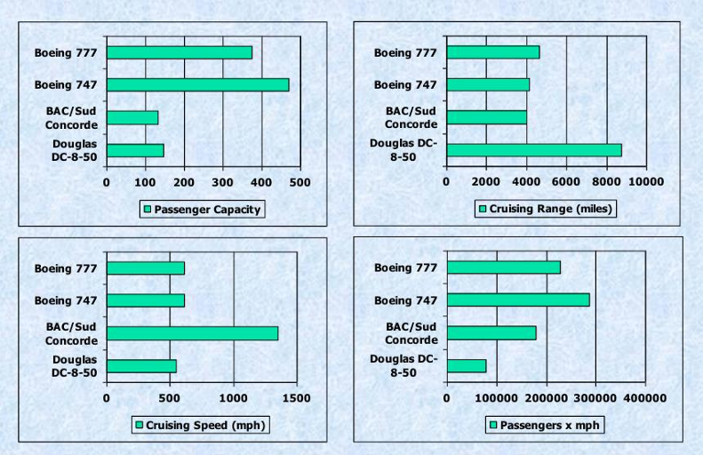
Which airplane has the best performance?

Slide 72
Is it all about speed? and what speed?
Response time
How long does it take for my job to run?
How long does it take to execute my job?

Slide 73
Instruction | Semantics | Addable? | Reason / Constraint Hit
mv rd, rs | rd ← rs | ✅ Yes | Maps to ALU add with zero; pure control alias
li rd, imm | rd ← imm | ✅ Yes | ALU computes 0 + imm; no new hardware
inc rd | rd ← rd + 1 | ✅ Yes | ALU add with immediate +1
dec rd | rd ← rd − 1 | ✅ Yes | ALU sub with immediate 1
neg rd, rs | rd ← −rs | ✅ Yes | ALU subtract: 0 − rs
getpc rd | rd ← PC | ✅ Yes | ALU passes PC through
seqz rd, rs | rd ← (rs == 0 ? 1 : 0) | ✅ Yes | Uses existing compare result routed to ALU output
abs rd, rs (relaxed) | `rd ← | rs | `
lwpi rd, 0(rs1) | rd ← Mem[rs1]; rs1 ← rs1 + 4 | ❌ No | Two architectural writes in one cycle
lwup rd, imm(rs1) | rd ← Mem[rs1+imm]; rs1 ← rs1+imm | ❌ No | Two ALU uses + two writes
swap rs1, rs2 | rs1 ↔ rs2 | ❌ No | Requires two register writes
mul rd, rs1, rs2 | rd ← rs1 × rs2 | ❌ No | ALU lacks multiplier hardware
div rd, rs1, rs2 | rd ← rs1 ÷ rs2 | ❌ No | ALU lacks divider hardware
popcnt rd, rs | rd ← number of 1s in rs | ❌ No | Requires reduction logic not present
cmovz rd, rs1, rs2 | if rs2==0 then rd←rs1 | ❌ No | Needs conditional writeback gating
skipz rs | if rs==0, PC ← PC+8 else PC+4 | ❌ No | PC update options insufficient
movm (rs1),(rs2) | Mem[rs2] ← Mem[rs1] | ❌ No | Requires two memory accesses
swp rs, imm(rd) | Mem[rd+imm]←rs; rd←rd+imm | ❌ No | One ALU, one writeback only

